Slide 1

Spring MVC Validation @InitBinder

Slide 2
White Space
•
Our previous example had a problem with white space
•
Last name field with all whitespace passed … YIKES!
•
Should have failed!
•
We need to trim whitespace from input fields
www.luv2code.com

Slide 3
@InitBinder
Advanced
•
@InitBinder annotation works as a pre-processor
•
It will pre-process each web request to our controller
•
Method annotated with @InitBinder is executed
www.luv2code.com

Slide 4
@InitBinder
•
We will use this to trim Strings
•
Remove leading and trailing white space
•
If String only has white spaces … trim it to null
•
Will resolve our validation problem … whew :-)
www.luv2code.com

Slide 5

Register Custom Editor in Controller
CustomerController.java
…
@InitBinder
public void initBinder(WebDataBinder dataBinder) {
StringTrimmerEditor stringTrimmerEditor = new StringTrimmerEditor(true); dataBinder.registerCustomEditor(String.class, stringTrimmerEditor);
}
…
www.luv2code.com

Slide 6
Spring MVC Validation Number Range: @Min and @Max

Slide 7
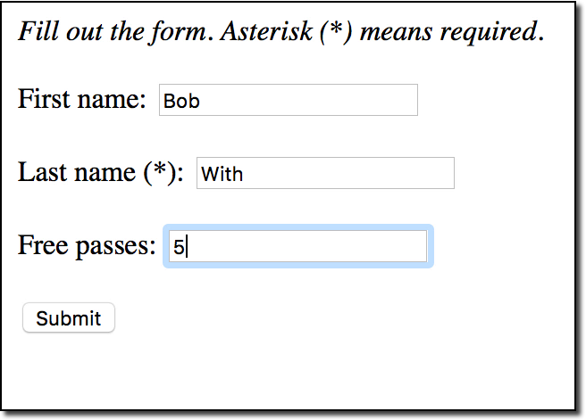
Validate a Number Range
•
Add a new input field on our form for: Free Passes
•
User can only enter a range: 0 to 10
www.luv2code.com

Slide 8
Development Process
Step-By-Step
Add validation rule to Customer class
Display error messages on HTML form
Perform validation in the Controller class
Update confirmation page
www.luv2code.com

Slide 9

Step 1: Add validation rule to Customer class
import javax.validation.constraints.Min; import javax.validation.constraints.Max;
public class Customer {
@Min(value=0, message="must be greater than or equal to zero") @Max(value=10, message="must be less than or equal to 10") private int freePasses;
// getter/setter methods
}
www.luv2code.com

Slide 10
Spring MVC Validation Regular Expressions

Slide 11
Regular Expressions
Advanced
A sequence of characters that define a search pattern
This pattern is used to find or match strings
Regular Expressions is like its own language (advanced topic)
I will assume you already know about regular expressions
If not, then plenty of free tutorials available
https://docs.oracle.com/javase/tutorial/essential/regex/
www.luv2code.com

Slide 12
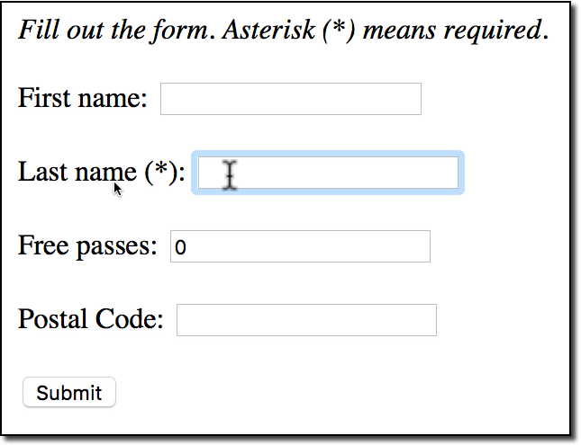
Validate a Postal Code
•
Add a new input field on our form for: Postal Code
•
User can only enter 5 chars / digits
•
Apply Regular Expression
www.luv2code.com

Slide 13
Development Process
Step-By-Step
Add validation rule to Customer class
Display error messages on HTML form
Update confirmation page
www.luv2code.com

Slide 14

Step 1: Add validation rule to Customer class
Advanced
import javax.validation.constraints.Pattern; public class Customer {
@Pattern(regexp="^[a-zA-Z0-9]{5}", message="only 5 chars/digits") private String postalCode;
// getter/setter methods
}
www.luv2code.com

Slide 15
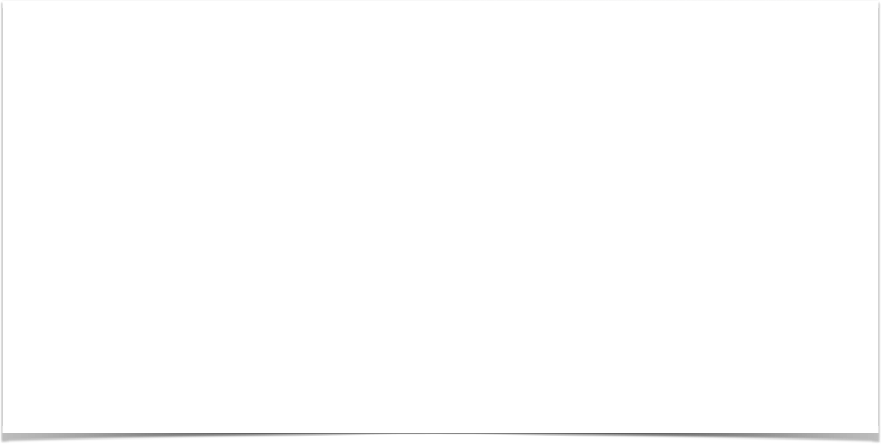

Spring MVC Validation Custom Validation

Slide 16
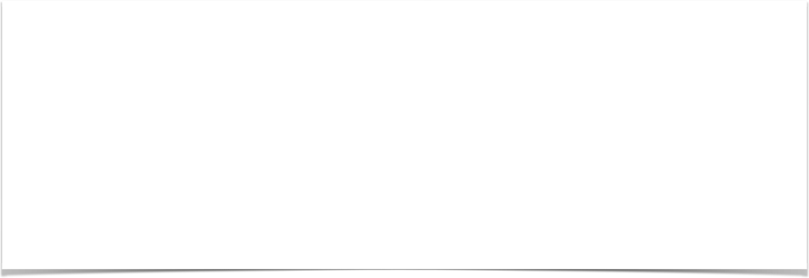
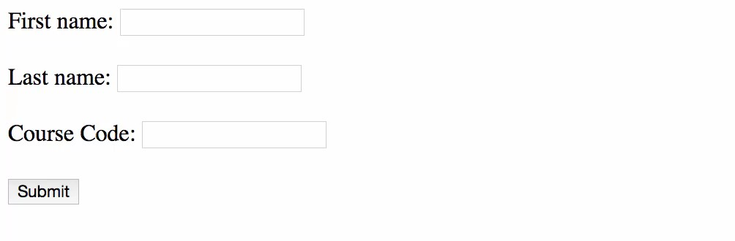
Custom Validation Demo
www.luv2code.com

Slide 17
Custom Validation
✤ Perform custom validation based on your business rules
✤ Our example: Course Code must start with “LUV”
✤ Spring MVC calls our custom validation
✤ Custom validation returns boolean value for pass/fail (true/false)
www.luv2code.com

Slide 18

Create a custom Java Annotation … from scratch
Advanced
✤ So far, we’ve used predefined validation rules: @Min, @Max, …
✤ For custom validation … we will create a Custom Java Annotation
✤ @CourseCode
@CourseCode(value="LUV", message="must start with LUV") private String courseCode;
www.luv2code.com

Slide 19
Development Process
Step-By-Step
Create custom validation rule
Add validation rule to Customer class
Display error messages on HTML form
Update confirmation page
www.luv2code.com

Slide 20
Development Process - Drill Down
Step-By-Step
Create custom validation rule
Create @CourseCode annotation
Create CourseCodeConstraintValidator
www.luv2code.com

Slide 21


Step 1a: Create @CourseCode annotation
Advanced
Usage Example
@CourseCode(value="LUV", message="must start with LUV") private String courseCode;
www.luv2code.com

Slide 22
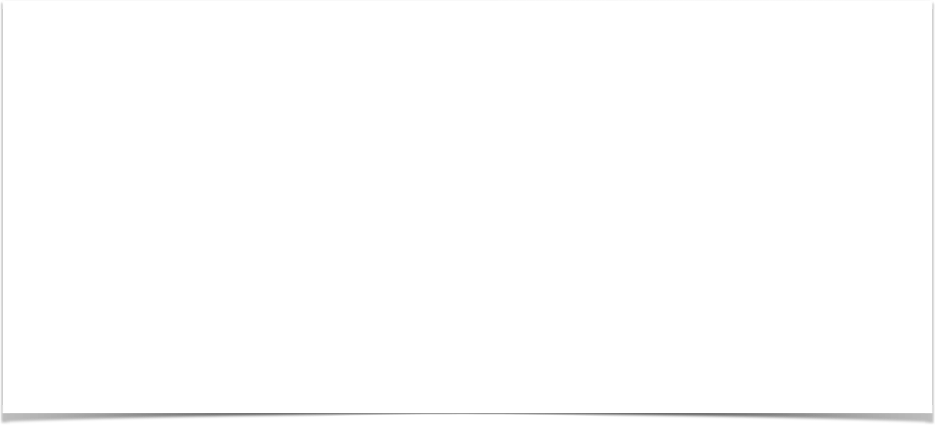
Step 1a: Create @CourseCode annotation
Advanced
@Constraint(validatedBy = CourseCodeConstraintValidator.class) @Target( { ElementType.METHOD, ElementType.FIELD } ) @Retention(RetentionPolicy.RUNTIME)
public @interface CourseCode {
...
}
@CourseCode(value="LUV", message="must start with LUV")
private String courseCode;
www.luv2code.com

Slide 23
Step 1a: Create @CourseCode annotation
Advanced
@Constraint(validatedBy = CourseCodeConstraintValidator.class) @Target( { ElementType.METHOD, ElementType.FIELD } ) @Retention(RetentionPolicy.RUNTIME)
public @interface CourseCode {
// define default course code
public String value() default "LUV";
// define default error message
public String message() default "must start with LUV";
...
}
@CourseCode(value="LUV", message="must start with LUV")
private String courseCode;
www.luv2code.com

Slide 24
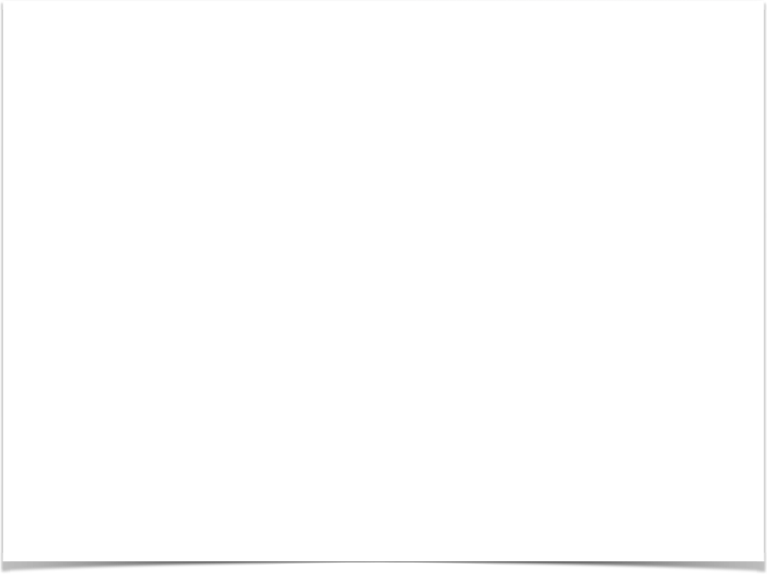
Step 1b: Create CourseCodeConstraintValidator
Advanced
import javax.validation.ConstraintValidator;
import javax.validation.ConstraintValidatorContext;
public class CourseCodeConstraintValidator
implements ConstraintValidator<CourseCode, String> {
private String coursePrefix; @Override
public void initialize(CourseCode theCourseCode) { coursePrefix = theCourseCode.value();
}
@Override
public boolean isValid(String theCode,
ConstraintValidatorContext theConstraintValidatorContext) {
boolean result;
if (theCode != null) {
result = theCode.startsWith(coursePrefix);
}
else {
result = true;
}
return result;
}
}
www.luv2code.com

